Slide 1
Warren Title I Program Home of the Wildcats
Annual Title I Parent Meeting August 15, 2023

Slide 2
Add school mascot
Warren
has been allocated
$ 134,160
in Federal Title I dollars for
School Year 2023-2024

Slide 3
The purpose of Title I is to ensure that all students …
…receive a high quality education
…from appropriately certified, well-trained staff
…who use evidence-based instructional methods

Slide 4
Title I Funds are for…
supporting struggling learners with additional resources and help in reading and mathematics.

Slide 5
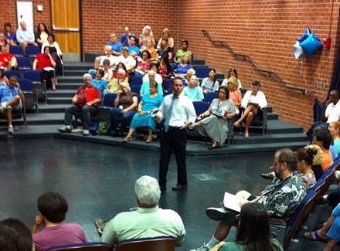
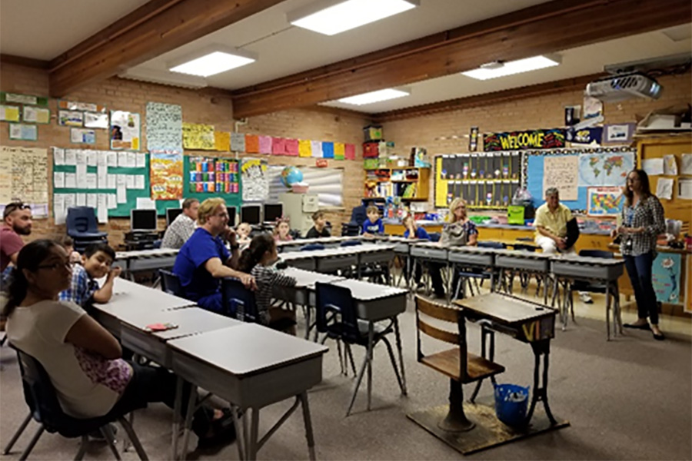
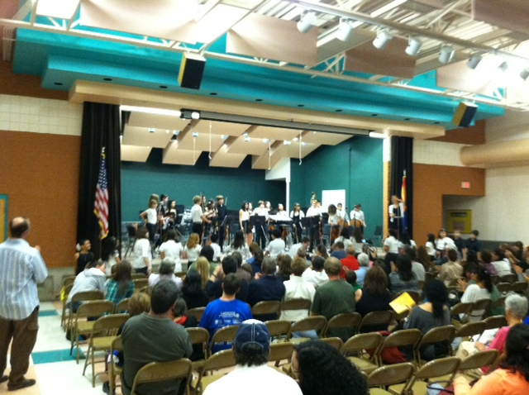
Title I funds help our school offer families
interactive learning opportunities
to
support student achievement at high academic levels

Slide 6
Arizona’s Academic Standards Assessment (AASA)
ELA-Reading | Math

Slide 7
School Letter Grade B
The Arizona Department of Education (ADE) assigns each school a letter grade based on spring 2022 Arizona’s Academic Standards Assessment results. When the information is received, we will notify our community.
School grades are based on:
The percentage of students who passed the Arizona’s Academic Standards Assessment (AASA) exam.
The percentage of students who attained academic growth reaching or exceeding grade level expectations.
Additional factors such as the percentage of students evaluated, graduation rate-High School Only, reclassification of English language students.
Title I funds help our school maintain / improve our school score by improving student achievement through the strategic use of federal funds.

Slide 8
Integrated Action Plan (IAP)
Our school leadership team composed of staff and families completed a needs assessment in the spring. We address student needs and allocate Title I resources to support:
Well trained staff using effective teaching practices
To provide intervention for struggling students
Families to help students achieve in school
**To participate in our planning process, please contact:____________

Slide 9
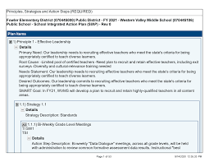
Integrated Action Plan (IAP)
To ensure that all students receive a high-quality education we employ appropriately certified staff, who use research based instructional methods. Our school plan includes the following:
90 minutes of regular reading instruction per day.
90 minutes of regular mathematics instruction per day
Teacher Training in Professional Leaning Communities and Wednesday’s PD Curriculum Service Providers to support ALL teachers

Slide 10
Integrated Action Plan (IAP)
To support struggling learners with additional resources and help in reading and mathematics, our school plan to improve reading achievement includes the following:
Reading/Math Interventions
20-30 minutes per day/week/month
Reading/Math Tutors
Tutoring will be held after school. More information to come soon.
To inquire about our tutoring program, please reach out to your child’s teacher.

Slide 11
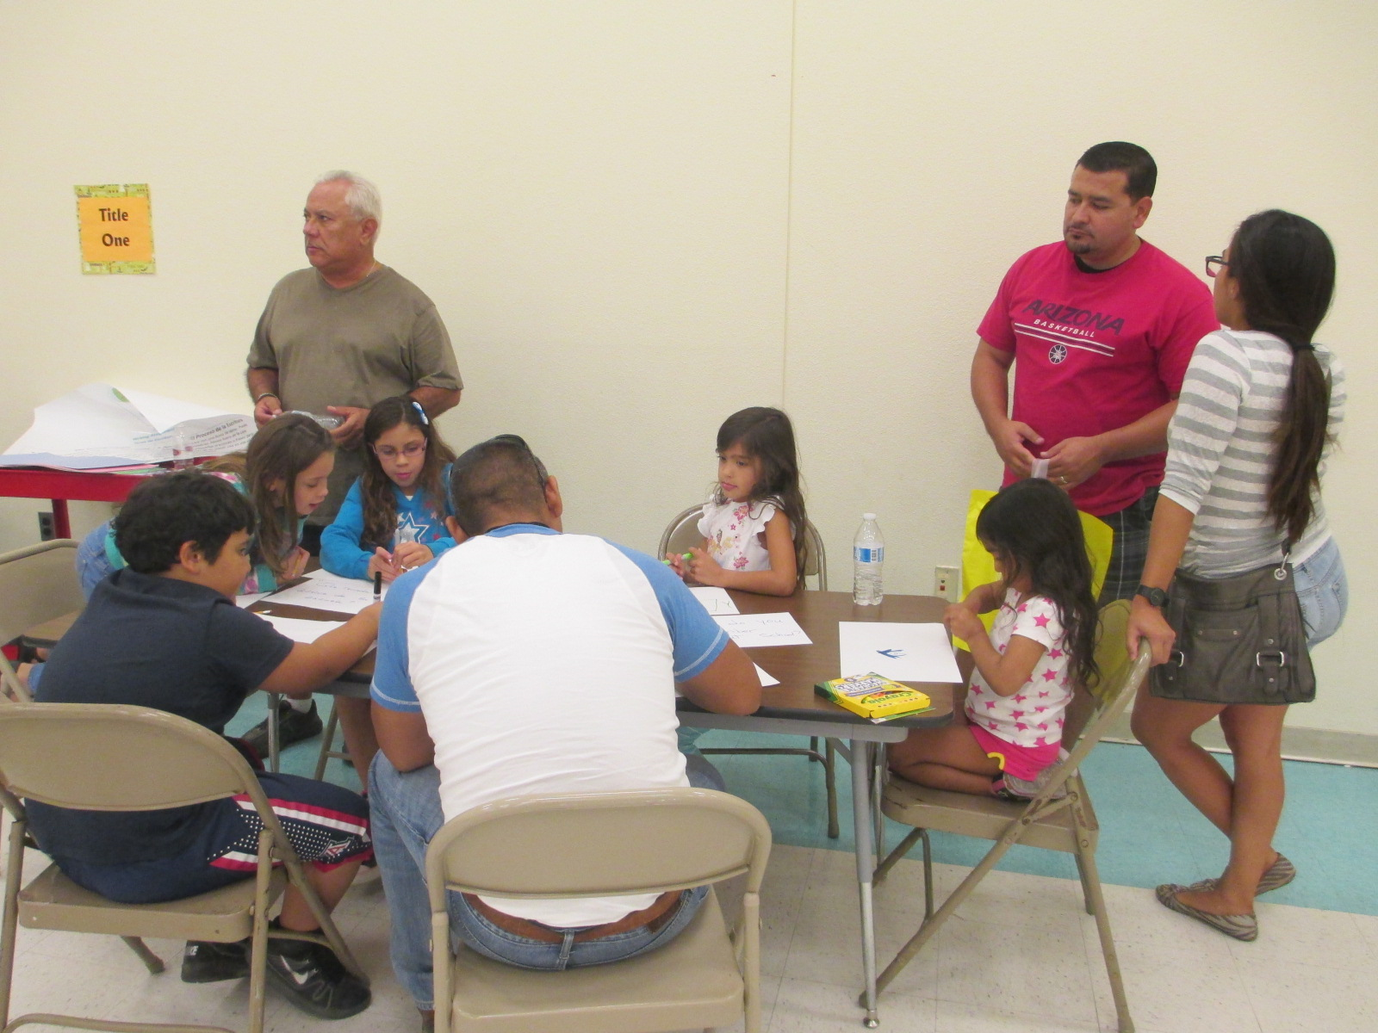
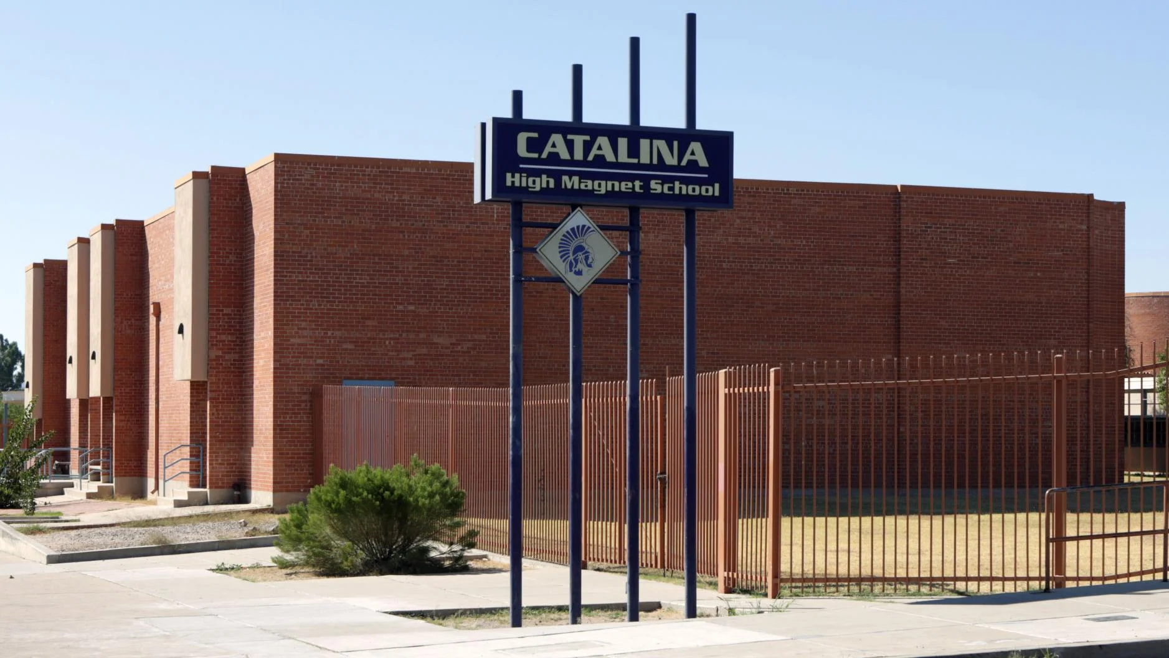
School Integrated Action Plan (IAP)
Academic Family Engagement
Our plan includes steps to promote academic family engagement:
District Parent Involvement Policy
School Parent Involvement Policy
Title I Parent Compact
TUSD Family Centers
Mary Quinones 520-908-4762
Events will be announced via…newsletter, website calendar, Facebook

Slide 12
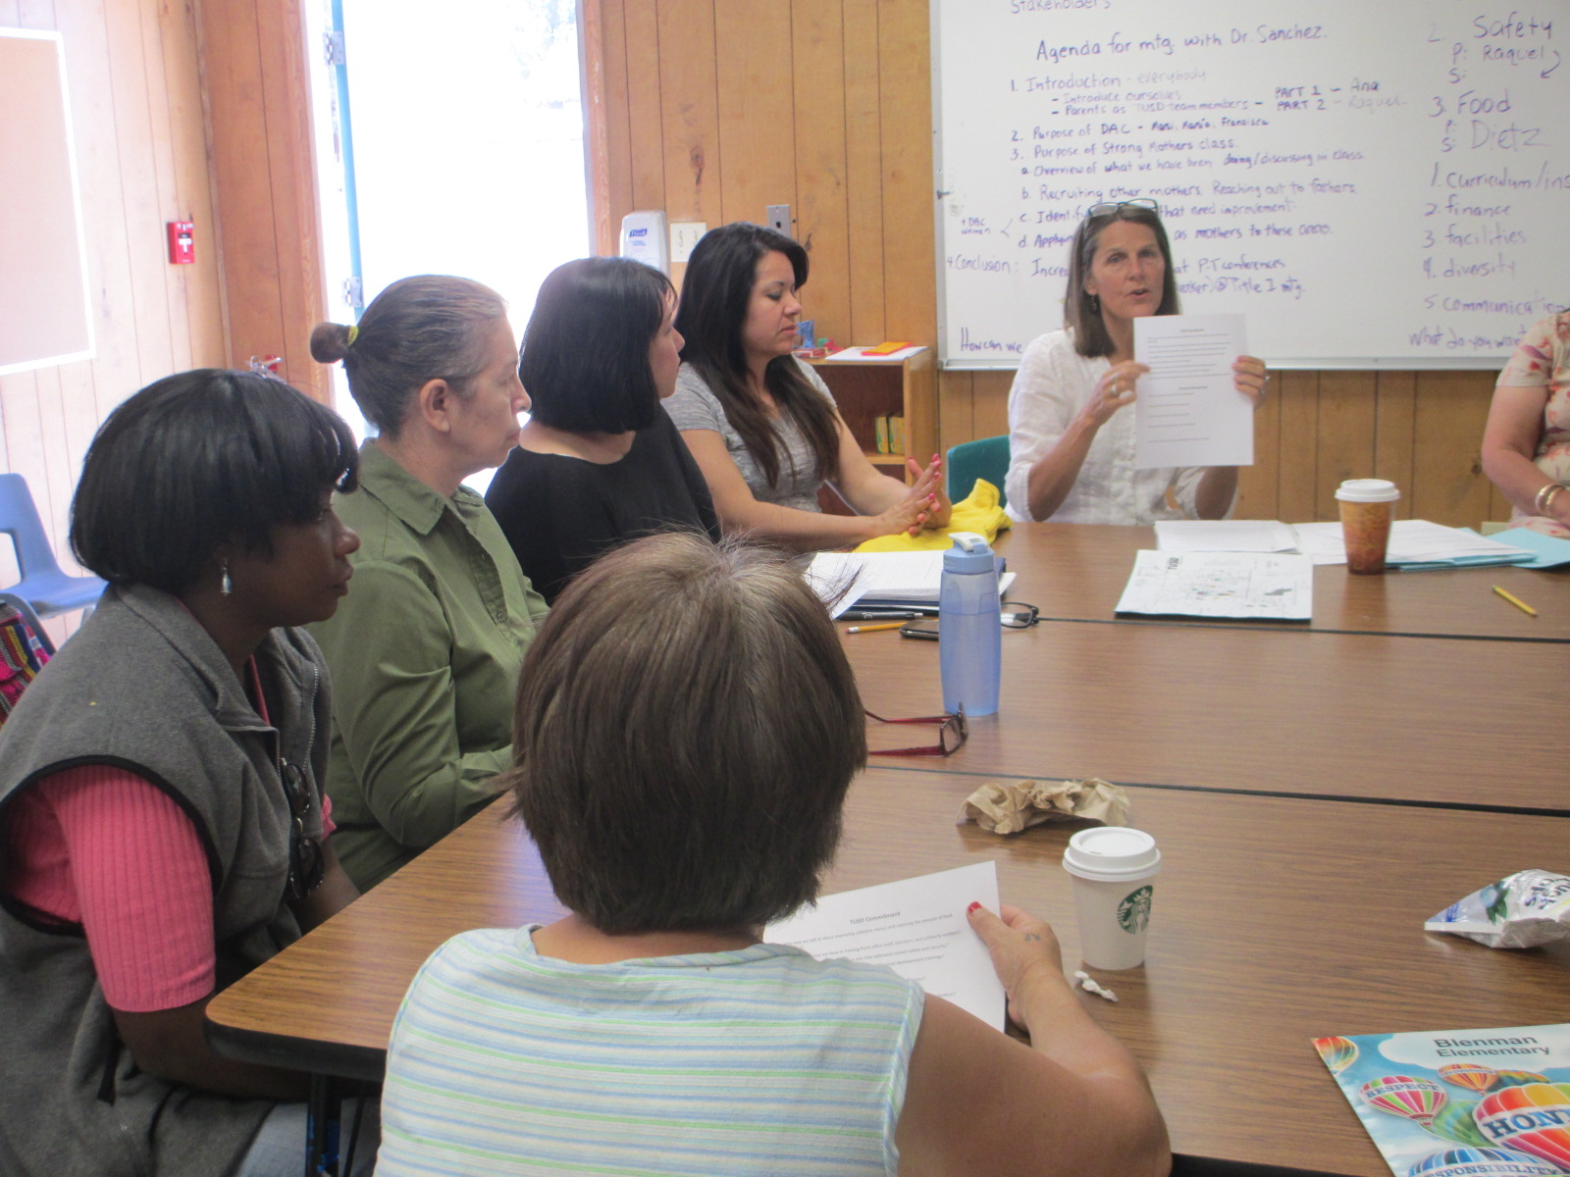
Parents Right to Know
You have the right to request:
The qualifications of your child’s teacher and instructional staff
Your child’s level of achievement based on required state assessments
You must be informed within 4 weeks if:
Your child is being taught by a teacher who does not meet the appropriately certified requirements of the state
All of this information must be in a language and format that is understandable to you.

Slide 13
Important Dates to Remember
No School – Wednesday, August 23
Site Council - August 29th @ 3:00pm
ELA Night- Wednesday, September 13th
Parent Teacher Conference
September 20-22
Fence Project- late August
For more information or to access the school Integrated Action Plan Contact:
Jill Ronsman jill.Ronsman@tusd1.org 520-908-4702
THANK YOU !

